Slide 1


Slide 2


Slide 3




Slide 4
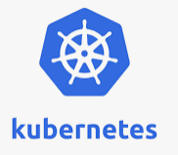
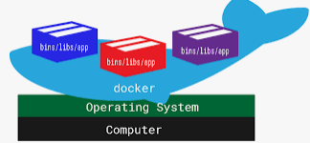
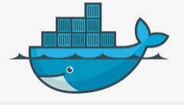
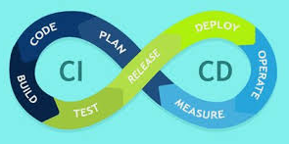

Slide 5

Let me Ask Question ?
How Familiar are you ?
Absolute Beginner
Professional

Slide 6


Expert
Beginners

Slide 7



Slide 8


Who have designed course ?

Slide 9

Course Structure
Modules
Concepts
Practical Demo
Practice Live Env
Quizzes
Challenge Exercises

Slide 10


Slide 12


Slide 13
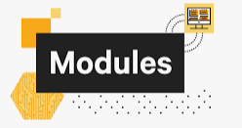


Openshift for Developers with Katakoda Practice
12 Modules
15 Live Practice Katakoda Scenerios
Resources
Github links

Slide 14

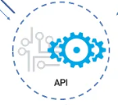






1 to 4
Introduction

Slide 15


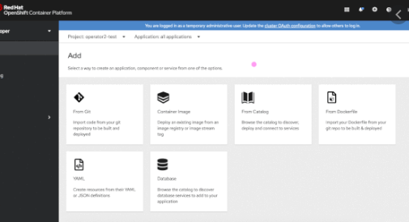
5 to 7
Openshift Options

Slide 16

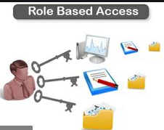

5 to 7

Slide 17
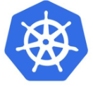


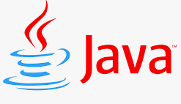

Master Node
Worker 1
Namespace/Project
Pod 1

Slide 18

8 to 11
Projects
Services
Quotas
Routes
Build & Build Strategies
ImageStreams
Deployments
Rollouts
Deployment Configs
Rollout Strategies

Slide 19
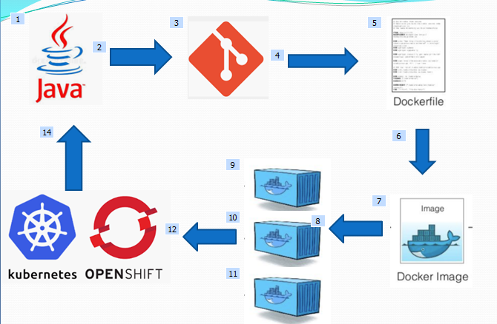
12

Slide 20
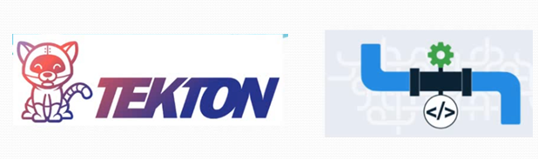
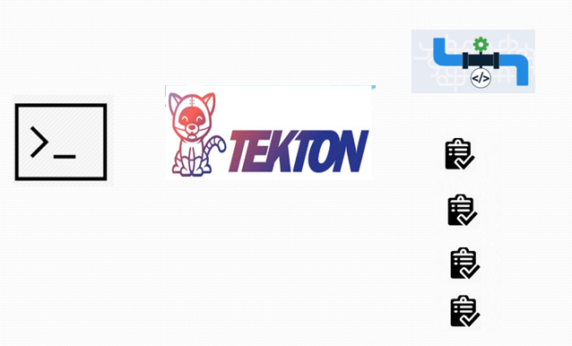
12
Openshift Pipelines

Slide 21
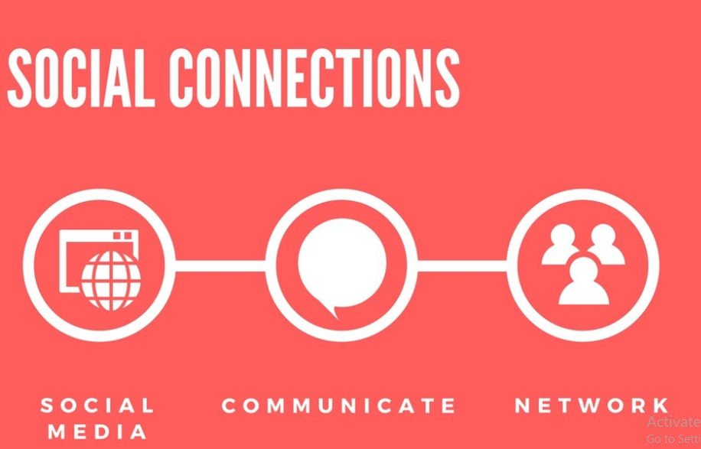

Slide 24
What is Open Shift ?
OpenShift would be classified a PaaS.
It is a platform to help you develop and then deploy applications to one or more hosts , in a distributed fashion
The only requirement is that the application can run within a container

Slide 25
What is Open Shift ?
containerized application platform that allows enterprises to accelerate and streamline
Application development
Delivery
Deployment on-premise or in the cloud
The platform integrates the tools to build and run applications,
Manages the complete application life cycle from initial development to production

Slide 26
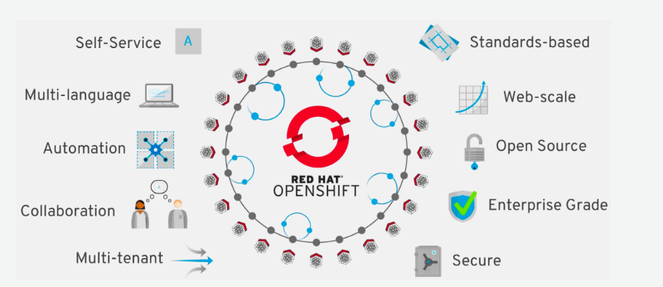
Features of Open Shift ?

Slide 27
Lets Discuss few one by one
Automation
Infrastructure Provisioning/Auto-Scaling /Heal
Health Check
Secure
Via RBAC /Cluster Role / Instance Roles
Certificates /Encryption
Open Source
Self Service
Collaboration
B/w Developers

Slide 28
Lets Discuss few one by one
Enterprise Grade
Comes with various versions according to requirement
Standard Based
Follow industries best practices and compliances

Slide 31

Introduction to Openshift playground

Slide 32

Introduction to Katakoda Practice Exercises

Slide 35
Understanding Architecture
OpenShift has microservices-based architecture of “small”, decoupled services that work together, running on top of a Kubernetes cluster

Slide 36
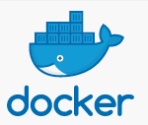


Docker provides the abstraction for packing and creating Linux based lightweight container images
Kubernetes provides the cluster management and orchestrating containers on multiple hosts.
OpenShift adds more into that are
essentially source code management,
builds, and deployments capabilities for developers, management
promotion of Docker images at scale, application management at scale,
team and user tracking for organizing large developer organizations

Slide 37
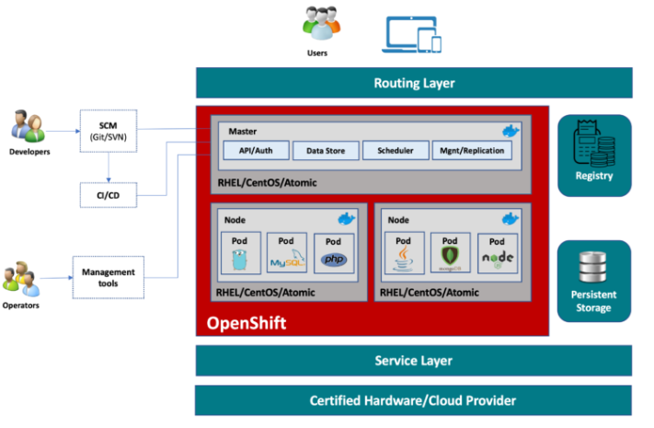

Slide 38
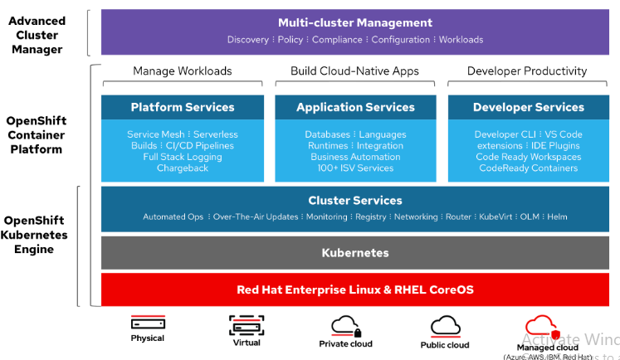

Slide 40
Openshift Online
Openshift Online
do not want to install and manage your own OpenShift cluster
free starter tier,
intended for experimentation,
testing,
development
When you are ready for production you can upgrade to Paid version

Slide 41
Openshift Dedicated
OpenShift cluster is reserved for your use and is not shared by other users outside your organization.
For Production
For Companies with strict compliances
It costs more

Slide 42
Openshift Origin
If you prefer to install and run OpenShift yourself,
On Premise
Personal VM’s
a set of Ansible playbooks
OpenShift Origin is a community-supported distribution of OpenShift

Slide 43
OCP (Openshift Container Platform)
If you would prefer to run your own OpenShift cluster
but have access to professional support services,
you can obtain a subscription for OpenShift Container Platform from

Slide 44
Learning & Local Installations
Openshift Online
Minishift
Code ready Containers
Openshift Play Ground
Katakoda

Slide 47
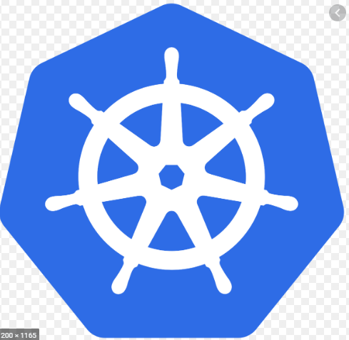
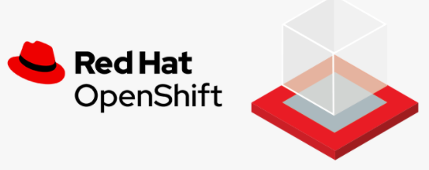
Kubernetes Vs Openshift

Slide 48


Openshift vs Kubernetes
OpenShift is a product that comes in many variants
OKD
OCP
includes components of the Kubernetes container management project,
but adds productivity and security features that are important to large-scale companies.
Open source project

Slide 49
Openshift vs Kubernetes
Limited Installation
RHEL/Core OS /CentOS
Cannot Install On Linux Distribution
More strict & Secure policies
Container Images on Docker hub will not run
As it forbids to run them as root
Can be installed any where including in Linux like Debian Ubuntu etc
Its focus is quickly deploy , simple apps

Slide 50

Openshift vs Kubernetes
Handling Images
Better Management in ImageStreams
Integrated CI/CD pipelines .
It is bit easier for beginners
A bit different approach to deployments
Security Scanning
In Built Monitoring / Better support
Management
Conventional Management

Slide 52

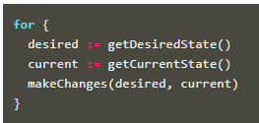
What are ?
take care of routine tasks to ensure the desired state of the cluster matches the observed state and they communicate with apiServer & etcd database
Nodes /Pods / Services / Token/Builds
each controller is responsible for a particular resource in the Kubernetes world
Some Examples include ReplicaSet/Deployment/Build Controller etc

Slide 53

Master Node
Service
Worker 1
Worker 2

Slide 54
Understanding etcd & apiServer

Slide 55


Master Node
Worker Node
Deployment 1
Deployment 2

Slide 57

Why oc client ?

Slide 58
What is use of oc client ?
Programmatically access our cluster
Useful for Automation Purpose
Are restricted by bandwidth resources and can not use the web console.

Slide 59

Lets Install it

Slide 60
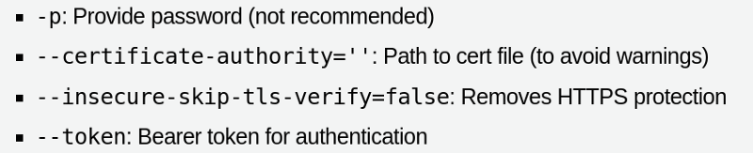
Basic oc commands
oc login -u $USERNAME {apiUrl}
oc whoami
oc whoami — show-server
oc whoami — show-console
oc whoami — show-token

Slide 63
Creating Resources via oc client

Slide 64


What is a Openshift resource ?
A resource is an endpoint in the Openshift API that stores a collection of API objects of a certain kind; for example, the built-in pods resource contains a collection of Pod objects.
Oc create -f
Pods
ReplicaSets
ReplicationController
Services
Routes
Ingress
Deployment
RestApi (exposes EndPoints)

Slide 65
YAML is a human-readable data serialization standard that can be used in conjunction with all programming languages and is often used to write configuration files
It’s a strict superset of JSON
YAML can
→self-reference,
→support complex datatypes, embed block literals,
→support comments
→ YAML tends to be more readable than JSON as well

Slide 66
apiVersion
kind
metadata
spec

Slide 69

Understanding different types of Users

Slide 70


System:admin
System:master
Service Accounts
System:serviceAccount

Slide 71
Understanding Service Accounts

Slide 72

Identity Providers (htpsswrd/gitlab/fb)
RBAC (Role Based Access control )
Namespace/Project 1
SA

Slide 73

Understanding RBAC in Openshift

Slide 74
RBAC
Cluster Role
Individual Project Role
Name
Resources
Pods/Deployments
Replicaset/ImageStream..etc
Role
Policy
Verbs
What action ?
get, list, create, update, delete etc

Slide 75
Some Imp commands of RBAC
View all roles and role bindings
oc describe clusterrole.rbac / oc describe clusterrolebinding.rbac
oc describe role.rbac / oc describe rolebinding.rbac
Add a role to user
oc adm policy add-role-to-user <role_name> <user_name>
oc adm policy add-role-to-user <role_name> <user_name> -n <project_name>
Create a custom role
oc create role <name> --verb=<verb> --resource=<resource> -n <project>
Form exp:
oc create role podview --verb=get --resource=pod -n demo

Slide 78
Understanding Concept of Projects
We organize application into projects , its nothing but a analogous to namespace in Kubernetes
By doing so we can put limits and quotas for particular project.

Slide 79
Ordering Project
Customer Details app
Order Details App
Place Order

Slide 80

What are issues with such type of approach?
What of there is VM Failure ?
What if there is sudden increase in demand of one app ?
What if an app due to some bug is taking more space and memory

Slide 81
Quota in terms of
CPU/Memory Usage
Customer Details app
Order Details App
Q1
Q2
S1
S2
S3
Q3
Place Order

Slide 82

logical grouping of applications
We can have same resource names within different project but need to have different resource name within project
Loose coupling

Slide 84
Understanding Quotas in Projects

Slide 85

Cluster Admin
A resource quota, defined by a ResourceQuota object on Project Level
It can limit the quantity of objects that can be created in a project by type,
Pods,ReplicaSet, Secrets etc
total amount of compute resources and storage
CPU (requests.cpu , limits.cpu)
Memory (requests.memory , limits.memory)

Slide 86
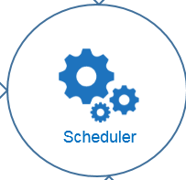
Master Node
Replicas=2
Worker 1
Worker 2

Slide 87
Master Node
Replicas=2
CPU : 9 GCPU
CPU : 3 GCPU
Worker 1
Worker 2
CPU : 4 GCPU
CPU : 4 GCPU

Slide 88
Master Node
Replicas=2
CPU : 9 GCPU
CPU : 5 GCPU
Worker 1
Worker 2
CPU : 4 GCPU
CPU: 4GCPU

Slide 89
Master Node
Replicas=2
NodeSelector: High CPU
High CPU
Low CPU
Worker 1
Worker 2

Slide 90
Using Taint & Tolerant
Master Node
Replicas=2
Yellow Taint
Worker 1
Worker 2
Tolerance=yellow

Slide 93
Creating Pod Resource

Slide 94
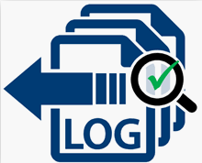
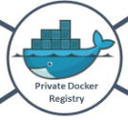
Master Node
Worker 1
Namespace/Project
Pod

Slide 95
Understanding ConfigMaps & Secrets

Slide 96
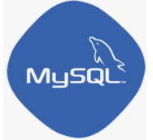
Master Node
Worker 1
Namespace/Project
Pod 1
Pod 2

Slide 97
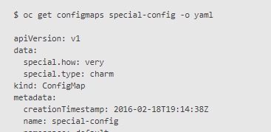
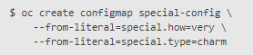
Creating ConfigMaps(CM)
Via Cli
From Literal Value
Via YAML

Slide 98
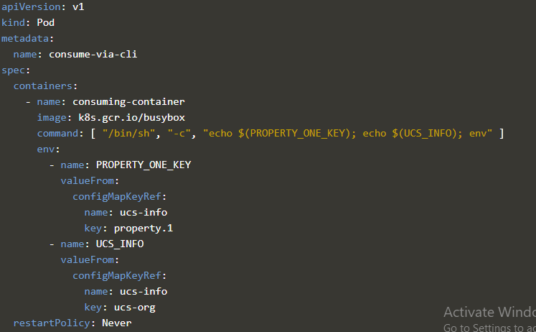
Consuming ConfigMaps(CM) via Pods
As Command line Arguments

Slide 99
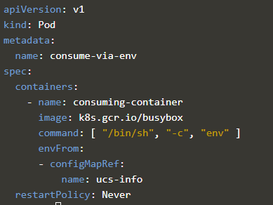
Consuming ConfigMaps(CM) via Pods
As Env Variables

Slide 100
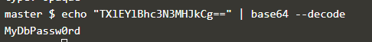
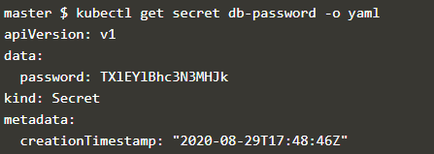
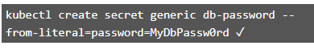
Creating Secrets
Via Cli
From Literal Value
Via YAML

Slide 103
Creating ReplicaSets & Replication Controller

Slide 104


Master Node
Worker 1
Namespace/Project
Replica Sets / Replication Controller
Replica=2
Pod
Pod

Slide 105
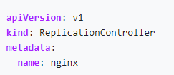
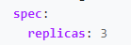
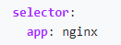
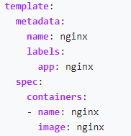
Replication
Controller

Slide 106
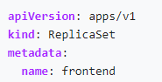
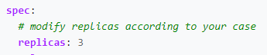
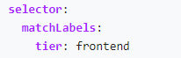
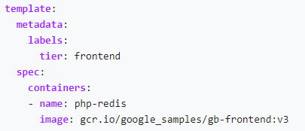
Existing Pods in Project
ReplicaSet

Slide 109
Demo :Understanding Need of Volumes

Slide 110


Master Node
Worker 1
Namespace/Project
Replica Sets / Replication Controller
Replica=1
Persistent Volume
PVC
Pod
Pod

Slide 111
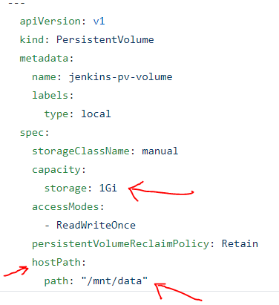
Sample Persistent Volume(PV) Yaml

Slide 112
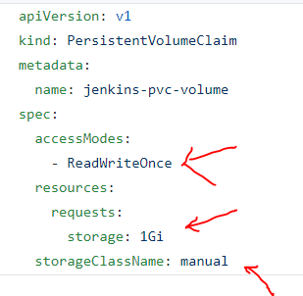
Sample Persistent Volume Claim (PV )Yaml

Slide 113
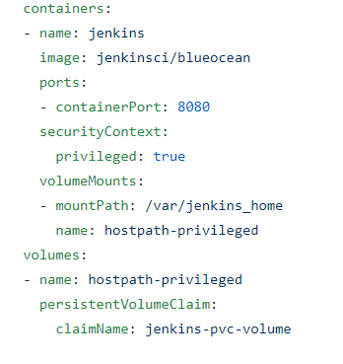
How to use inside Pod

Slide 116

Understanding Image Streams

Slide 117
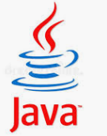
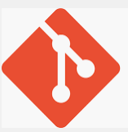
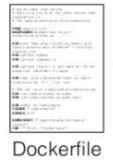
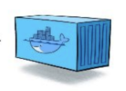
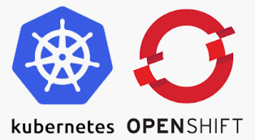
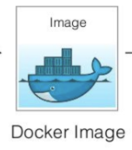

Slide 119
Understanding Multi-Container Pod Networking

Slide 120


Master Node
Worker 1
Namespace/Project
IP Address
Port:80
Pod
Localhost:80

Slide 122

Understanding Services

Slide 123
Master Node
Worker 1
Namespace/Project
(Frontend)
Deployment
Replicas=2

Slide 124





Master Node
Worker 1
Selector: db
Service (ClusterIP)
Namespace/Project
(Frontend)
Namespace/Project
(Backend)
Deployment 1
Deployment 2
Replicas=2
Replicas=2
Label: db
Label: db

Slide 125
Service(NodePort) (NodeIP: Port)
Master Node
Selector: app
Worker 1
Service (ClusterIP)
Namespace/Project
(Frontend)
Namespace/Project
(Backend)
Deployment 1
Deployment 2
Replicas=2
Replicas=2
Label: app
Label: db

Slide 126
Understanding Routers

Slide 127


(NodeIP: Port)→ DomainName
Routers(Domain Name)
Service(NodePort) (NodeIP: Port)
Selector: app
Master Node
Worker 1
Service (ClusterIP)
Selector: db
Replicas=2
Replicas=2
Label: app
Label: db
Label: db
Label: app

Slide 128


Oc expose svc {Service Name}
(NodeIP: Port)→ DomainName

Slide 130
Understanding Pod Networking in single namespace

Slide 131

Master Node
Worker 1
DNS Server
ServiceIP→ ServiceName
Namespace/Project
IP Address
Service
Pod1
Servicename:ContainerPort
Port:80
Pod2

Slide 132
Understanding Pod Networking in different namespace

Slide 133
Master Node
Worker 1
{{ServiceName}}.{{Namespace}}.svc.cluster.local
DNS Server
ServiceIP→ ServiceName
Namespace2/Project2
Namespace1/Project1
Pod1
Service
FQDN:ContainerPort
Pod2
Port:80

Slide 135
Understanding Multi-Container Pod Networking

Slide 136
Master Node
Worker 1
Namespace/Project
IP Address
Port:80
Pod
Localhost:80

Slide 137
Understanding Pod Networking in single namespace

Slide 138
Master Node
Worker 1
DNS Server
ServiceIP→ ServiceName
Namespace/Project
IP Address
Service
Pod1
Servicename:ContainerPort
Port:80
Pod2

Slide 139
Understanding Pod Networking in different namespace

Slide 140
Master Node
Worker 1
{{ServiceName}}.{{Namespace}}.svc.cluster.local
DNS Server
ServiceIP→ ServiceName
Namespace2/Project2
Namespace1/Project1
Pod1
Service
FQDN:ContainerPort
Pod2
Port:80

Slide 142

Understanding How Operators Works ?

Slide 143

Controllers that act upon and manage these recourses . Controllers encompass how to manage these recourses

Slide 144
Master Node
Worker 1
Namespace/Project
Replica Set
Replicas=1

Slide 145
Create a crd (Added a term to k8 vocabulary hat cloudpassion exists)
create a custom resource of type cloud passion

Slide 146


Slide 147


Master Node
Worker 1
Custom Resource(CR)

Slide 148



The logic to handle application is written by whoever who writes the operator
All the human knowledge is codified in operator .
Operator itself runs as a pod on k8s cluster , interacts with k8s api to manage
So code is written in Operator SDK --> Tool provided by k8s Open Source

Slide 149
Understanding Operators in Openshift

Slide 150




What are Operators ?
Operators are pieces of software that ease the operational complexity of running another piece of software.
Update
Patch
Backup & Recovery
Version change
Lifecycle management

Slide 151

What are Operators ?
Take all operational knowledge & put them into code

Slide 152



When you feel that your operation work is too
Heavy and time consuming
This must be done inside the cluster where
Application is deployed i.e K8s/Openshift

Slide 154
Understanding Basics of Deployment

Slide 155
Master Node
Route
Service
Worker 1
Namespace/Project
Deployment
Replicas=2

Slide 156
Master Node
Service
Worker 1
Worker 2

Slide 157
Deploying an Application in Project

Slide 158



Available Methods
From Code stored in Standard Source control

Slide 159





Available Methods
From Container Images

Slide 160

Available Methods
From Catalog
If you have your own
DockerFile
Yaml Manifest

Slide 162
Understanding Build Process

Slide 163
Concepts to Understand
Build
the process is used to transform input parameters or source code into a runnable image
Build Strategy
that are based on selectable types specified in the build API
S2I /Docker build/Custom Build

Slide 164
Concepts to Understand
BuildConfig
Object created in Openshift
Which has definition of the entire build process
Run policy
How new builds are scheduled (Squentially/Simultaneously)
Trigger
How a build invoked
Github Trigger
Image Change
Configuration Change

Slide 166

Understanding Trigger Process

Slide 167
What is Trigger
Process of automatically starting a build based on certain events
Events can Include
Push Event in Git via developer
Configuration Changes
Image Change

Slide 168

Push Event in Git via developer

Slide 170
Understanding S2I Build Strategies

Slide 171
Why to use S2I Build strategy ?
So that developer should concentrate on coding part
They donot need to learn docker containers etc
How to configure them
As there are many Builder Images already available
Plus if we need to create custom builder image . It is write once and share to many principle

Slide 172
S2I (Source to Image ) Strategy
Convert a source code on runnable application
There are several tools like buildah
Which Creates a Builder Image which only needs i/p as source code
As converts it into runnable Image
S2I supports incremental builds, which re-use previously downloaded dependencies, previously built artifact

Slide 173
buildah tools

Slide 175
Understanding Canary Deployments / Rolling Update Strategy

Slide 176
Deployment/DeploymentConfig

Slide 177
Use Cases
When you want to take no downtime during an application update.
When your application supports having old code and new code running at the same time.

Slide 180
Understanding Pod Lifecycle

Slide 181



Pod Lifecycle
Pending
Pod
Status
Container Creating
Pod
Status
Running

Slide 182


Routers
Services
Running/Ready

Slide 183









Readiness Probe

Slide 184


Routers
Services
Liveness Probe

Slide 187
Understanding Recreate Strategy

Slide 188
Deployment/DeploymentConfig

Slide 189
Use Cases
When you do not support having new and old versions of your application code running at the same time
When you must run migrations or other data transformations before your new code starts.

Slide 191


Understanding Demo Project with Openshift Pipelines

Slide 192







Feature 1
Feature 2

Slide 193


Feature 2

Slide 194


Slide 195



S2I Imagebuilder
Build Image

Slide 196
oc patch deployment
oc apply -f
Apply Manifest
Patch Deployment

Slide 197
Openshift Pipelines Demo: Step1 Install Openshift Pipeline Operator

Slide 198

executes PipelineRuns on your behalf
required permissions to run privileged pods for building images.
set of permissions allows pipeline to push a container image to OpenShift's internal image registry
only able to push to a section of OpenShift's internal image registry that corresponds to your OpenShift project namespace

Slide 199
Openshift Pipelines Demo: Step1 Install Tekton CLI

Slide 200


